Slide 1
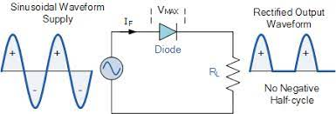
What is a Half Wave Rectifier?
A half wave rectifier is defined as a type of rectifier that only allows one half-cycle of an AC voltage waveform to pass, blocking the other half-cycle.
Half-wave rectifiers are used to convert AC voltage to DC voltage, and only require a single diode to construct.

Slide 2
Half Wave Rectifier Waveform

Slide 3
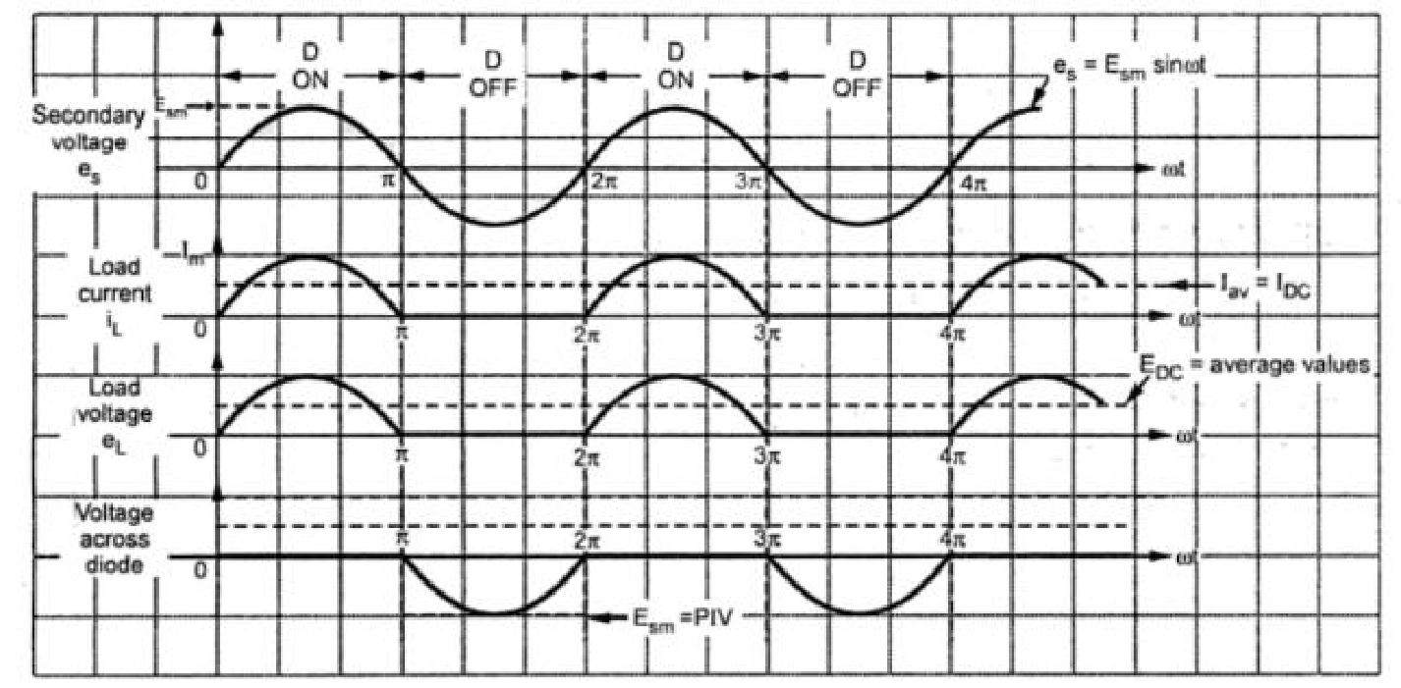
Half Wave Rectifier Waveform

Slide 4
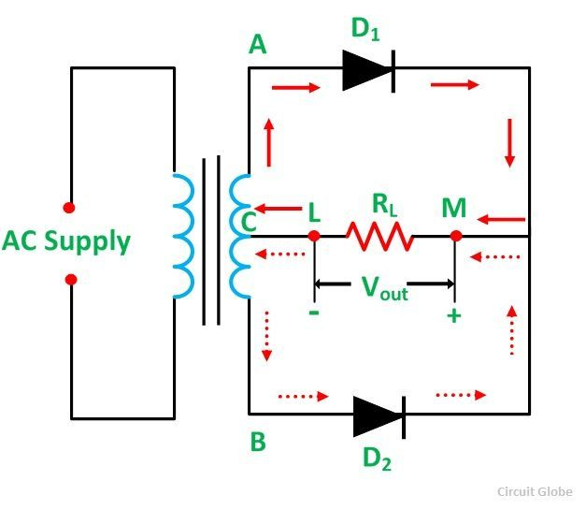
Center-tapped Full wave rectifier
Definition:
A rectifier circuit whose transformer secondary is tapped to get the desired output voltage, using two diodes alternatively, to rectify the complete cycle is called as a Center-tapped Full wave rectifier circuit.

Slide 5
During positive half-cycles, D1 is forward-biased and D2 is reverse-biased.

Slide 6
During negative half-cycles, D2 is forward-biased and D1 is reverse-biased.

Slide 7
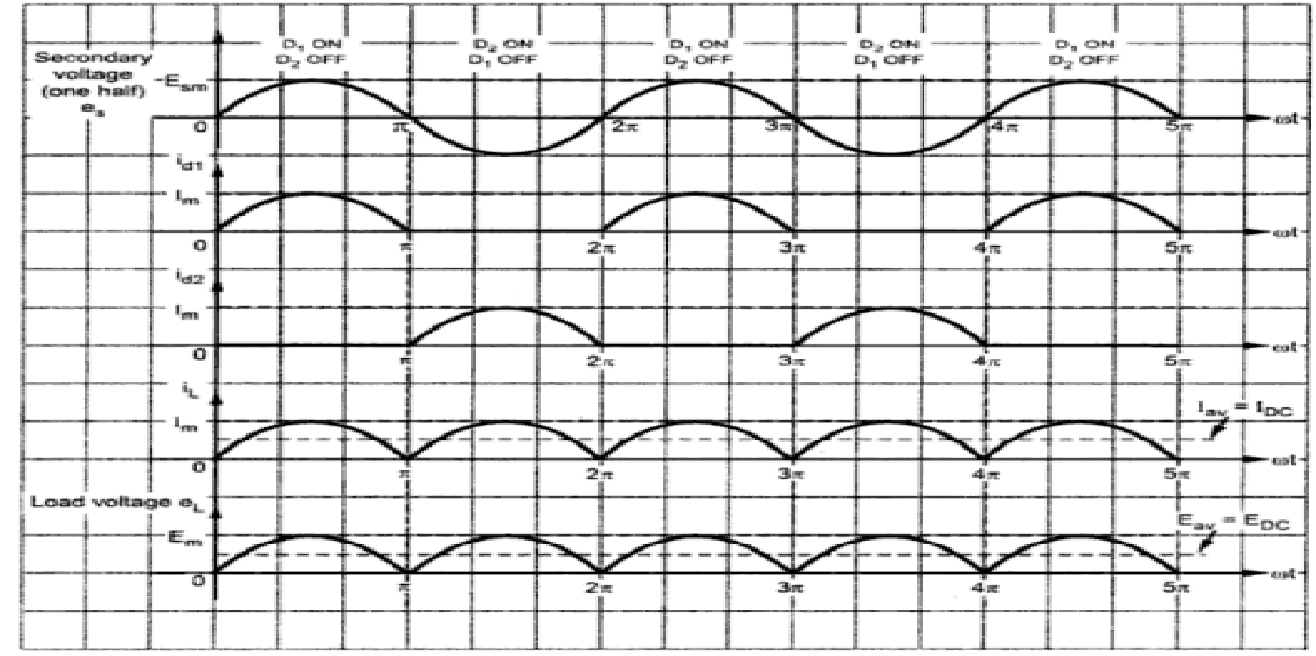
Center-tapped Full wave rectifier Waveform

Slide 10
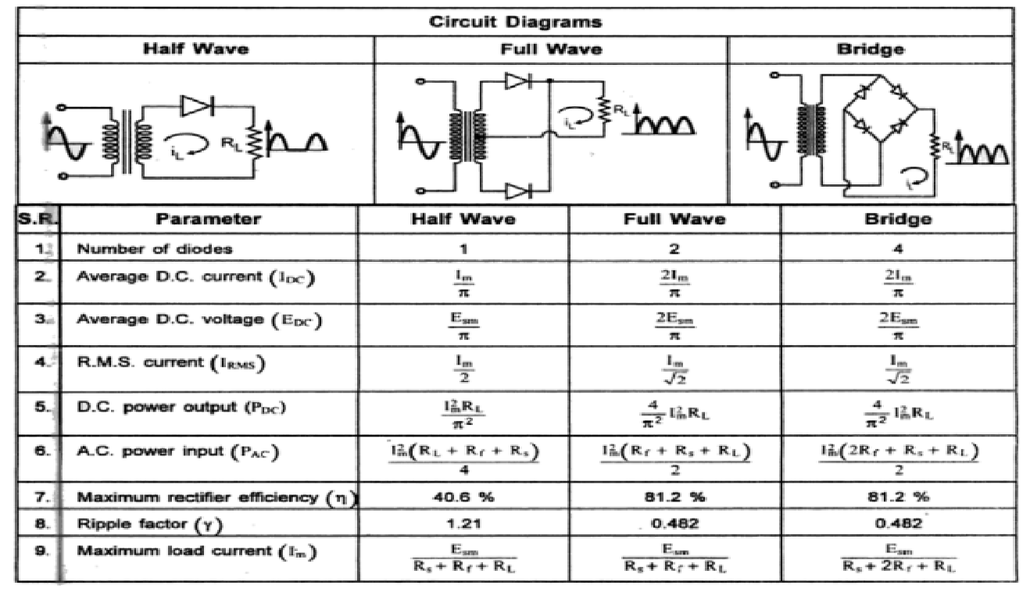

Slide 11
Thank you

Slide 12
Clipper Circuit
Definition:
A Wave Shaping circuit which control the shape of out waveform by removing or clipping a portion of the applied wave is known as Clipper.
The Diode Clipper, also known as a Diode Limiter.
Positive Clipper
Two Types
Negative Clipper

Slide 13
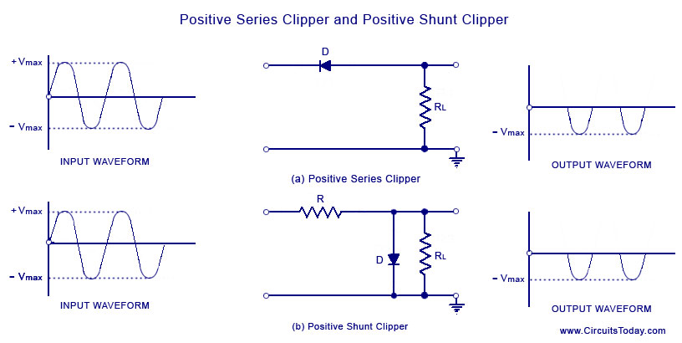

Slide 14
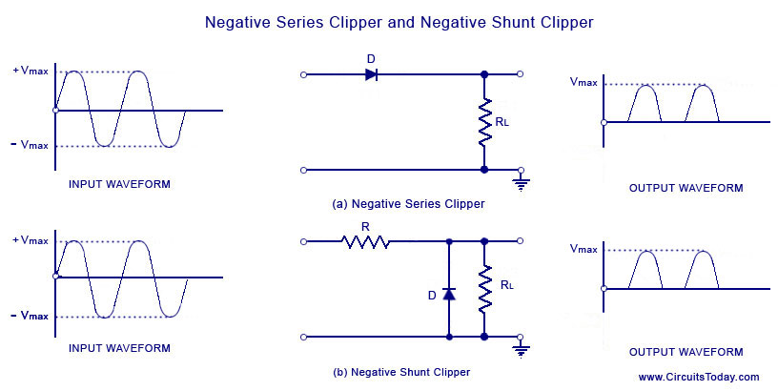

Slide 15
Clamper Circuit
Clamping is process of introducing a dc level into an ac signal.
Clamping circuit is a device that place either the positive or negative peak of a signal at a desired level.
The clamper circuits are also known as dc resistors.
The construction of the clamper circuit is almost similar to the clipper circuit.
The only difference is the clamper circuit contains an extra element called capacitor. A capacitor is used to provide a dc offset (dc level) from the stored charge.

Slide 16
Clampers
Application:
Used as direct current restorers
Used to remove distortions
Used as voltage multipliers
Used for the protection of amplifiers
Used as test equipment

Slide 17
Application:
Clippers
Used for the generation and shaping of waveforms
Used for the protection of circuits from spikes
Used for amplitude restorers
Used as voltage limiters
Used in television circuits
Used in FM transmitters

Slide 18
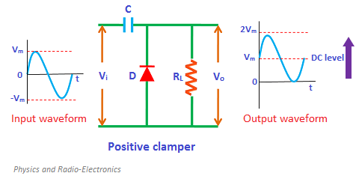
Positive Clamper
The dc component is simply added to the input signal or subtracted from the input signal.
A clamper circuit adds the positive dc component to the input signal to push it to the positive side.
If the circuit pushes the signal upwards then the circuit is said to be a positive clamper.
When the signal is pushed upwards, the negative peak of the signal meets the zero level.
Positive clamper passes the input signal to the output load when the diode is reverse biased and blocks the input signal when the diode is forward biased.

Slide 19
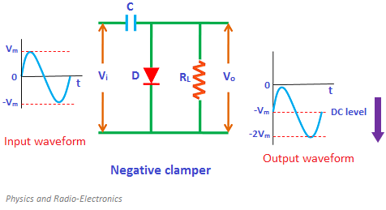
Negative Clamper
If the circuit pushes the signal downwards then the circuit is said to be a negative clamper. When the signal is pushed downwards, the positive peak of the signal meets the zero level.

Slide 20
Negative Clamper
During the negative half cycle of the input AC signal, the diode is reverse biased and hence the signal appears at the output. In reverse biased condition, the diode does not allow electric current through it. So the input current directly flows towards the output.
When the negative half cycle begins, the diode is in the non-conducting state and the charge stored in the capacitor is discharged (released). Therefore, the voltage appeared at the output is equal to the sum of the voltage stored in the capacitor (-V_{m}) and the input voltage (-V_{m}) {I.e. V_{o} = -V_{m}- V_{m} = -2V_{m}} which have the same polarity with each other. As a result, the signal shifted downwards.

Slide 21
Bias Clamper
Sometimes an additional shift of DC level is needed. In such cases, biased clampers are used.
The working principle of the biased clampers is almost similar to the unbiased clampers.
The only difference is an extra element called DC battery is introduced in biased clampers.

Slide 22
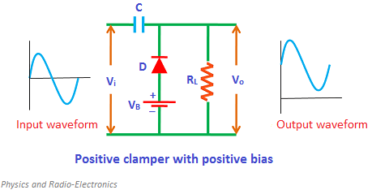
Positive Clamper with Positive bias
During the positive half cycle, the battery voltage forward biases the diode when the input supply voltage is less than the battery voltage. This current or voltage will flows to the capacitor and charges it.
During negative half cycle:
During the negative half cycle, the diode is forward biased by both input supply voltage and battery voltage. So the diode allows electric current. This current will flows to the capacitor and charges it.

Slide 23
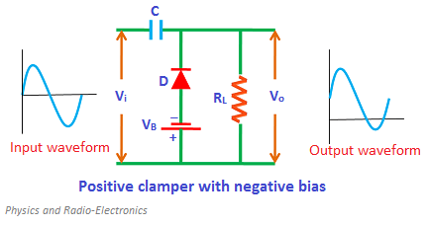
Positive clamper with negative bias
During negative half cycle:
During the negative half cycle, the battery voltage reverse biases the diode when the input supply voltage is less than the battery voltage. As a result, the signal appears at the output.
When the input supply voltage becomes greater than the battery voltage, the diode is forward biased by the input supply voltage and hence allows electric current through it. This current will flows to the capacitor and charges it.
During positive half cycle:
During the positive half cycle, the diode is reverse biased by both input supply voltage and the battery voltage. As a result, the signal appears at the output.
The signal appeared at the output is equal to the sum of the input voltage and capacitor voltage.

Slide 24
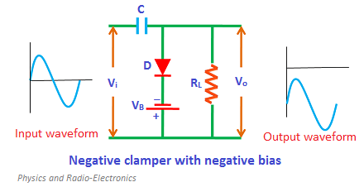
Negative clamper with negative bias
During positive half cycle:
During the positive half cycle, the diode is forward biased by both input supply voltage and battery voltage. As a result, current flows through the capacitor and charges it.
During negative half cycle:
During the negative half cycle, the battery voltage forward biases the diode when the input supply voltage is less than the battery voltage. When the input supply voltage becomes greater than the battery voltage, the diode is reverse biased by the input supply voltage and hence signal appears at the output.
.

Slide 25
During negative half cycle:
During the negative half cycle, the diode is forward biased by both input supply voltage and battery voltage. So the diode allows electric current. This current will flows to the capacitor and charges it.

Slide 26
Reference Video link
Center Tapped FWR - Peak Inverse Voltage
https://youtu.be/t8VyKQtHSUE
https://www.youtube.com/watch?v=kLRuU3VcXPA

